Slide 1
Saddle point search with dynamic active volume
Tao Liang, Haixuan Xu
The university of Tennessee Knoxville, Department of materials science and engineering
September 3rd 2025

Slide 2
Installation
SEAKMC_py itself does NOT include any energy or force evaluator. The python wrapper of LAMMPS (pyLAMMPS) is fully implemented in SEAKMC_py
It requires a dynamic LAMMPS library to install pyLAMMPS. If you have an external force field package that have an interface to LAMMPS, you need to compile it with a dynamic library.
Follow the instructions to install anaconda.
Create a virtual environment.
> conda create -p path_to_seakmc_env/seakmc_env
Activate the seakmc_env.
>conda activate path_to_seakmc_env/seakmc_env
Install LAMMPS using conda.
seakmc_env>conda install lammps=*=*mpich*
or seakmc_env>conda install lammps=*=*openmpi*
Install OpenKIM package:
seakmc_env>conda install openkim-models
Install pymatgen.
seakmc_env>conda install --channel conda-forge pymatgen
Install mpi4py (version <=3.1.6).
seakmc_env>python -m pip install mpi4py==3.1.6
Install SEAKMC_py_parallel.
seakmc_env>git clone https://github.com/TaoLiang120/SEAKMC_py_parallel.git
seakmc_env>cd SEAKMC_py_parallel
seakmc_env>python setup.py install or pip install .
Install compilers in conda:
conda create -p yourVenv python=3.12
conda activate yourVenv
conda install -c conda-forge pymatgen
conda install -c conda-forge cmake boost pybind11 fftw compilers libblas liblapack gfortran blas lapack
conda install -c conda-forge mpi4py=3.1.6
Make file of the interface:
- add " -rdynamic" to "CPPFLAGS += -fPIC"
- add " -rdynamic" to "CXXFLAGS += -fPIC"
- add " -rdynamic -shared" to "FFLAGS += -fPIC"
Follow the steps of LAMMPS /pyLAMMPS intallation:
2

Slide 3
Outline
Background and introduction
Dimer method
Active volume
Dynamic active volume (DAV)
Rescaling the dimer axis
Examples of SPS with DAV
Fe-SIL
Implementation of SPS with DAV
Flowchart
Parallization scheme
Determination of active volumes

Slide 4
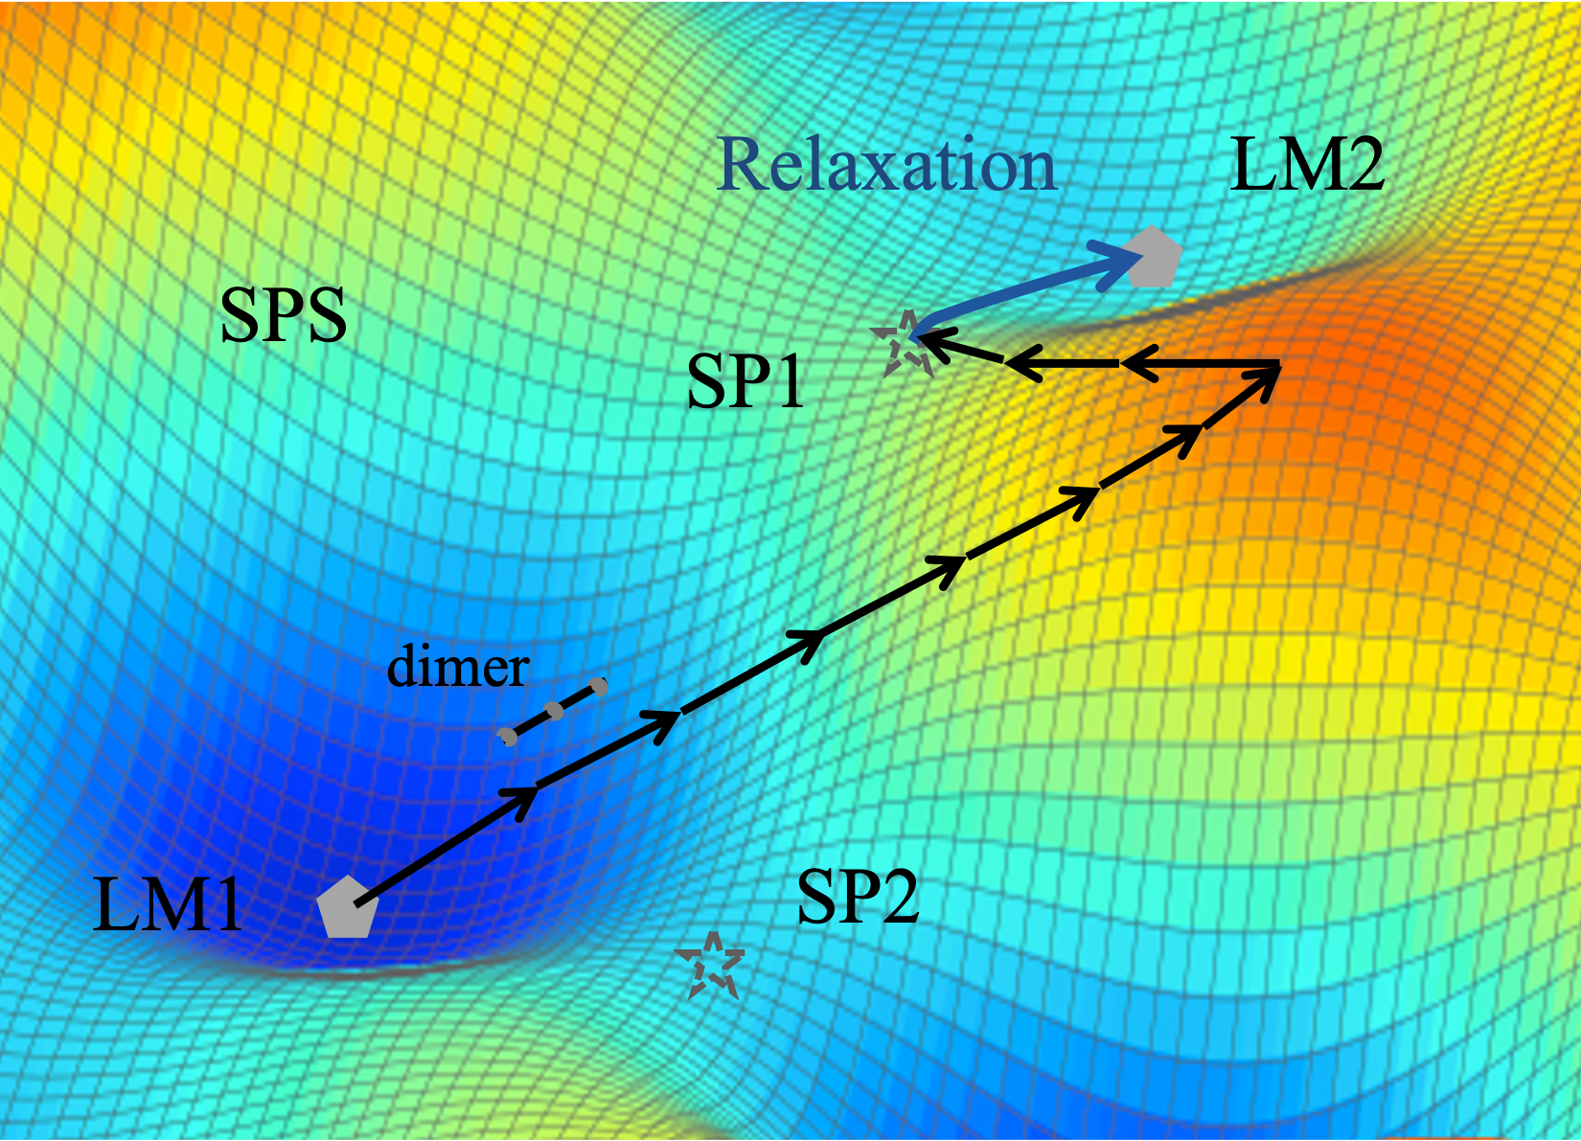
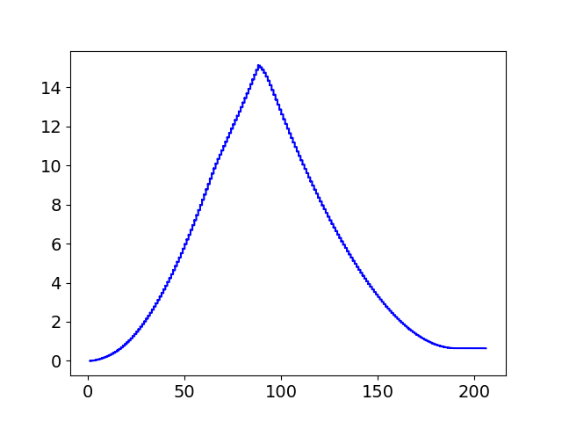
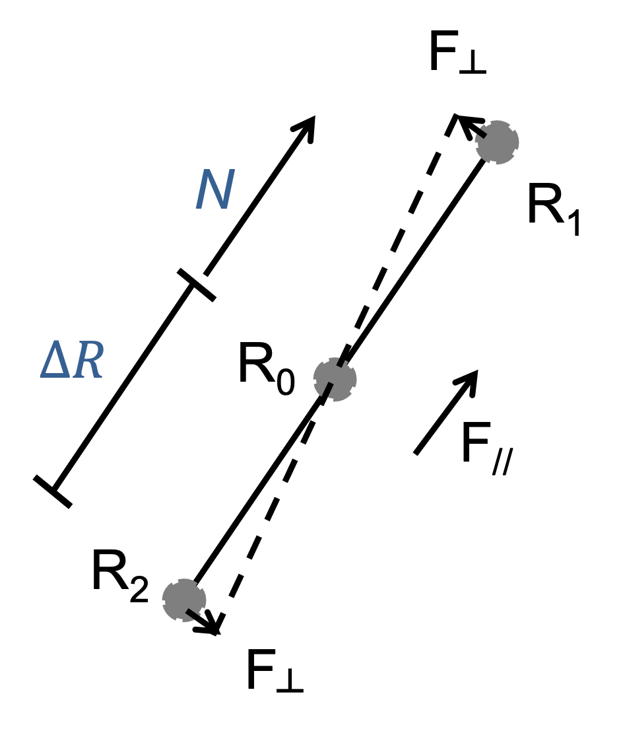
Dimer method
max
max
Elevation
Converging
Energy (eV)
A2
A1
0.64 eV
A4
A3
Translation steps
Elevation stage: dimer translates uphill
Converging stage: dimer translates downhill
Dimer axis (N): a unit vector of R₁ – R₂
G. Henkelman and H. Jonsson, JCP 111, (1999)
Notes:
No detail on dimer method
Highlight elevation / converging stages
A SP that is immediately connecting between initial and final states are a connected sp

Slide 5
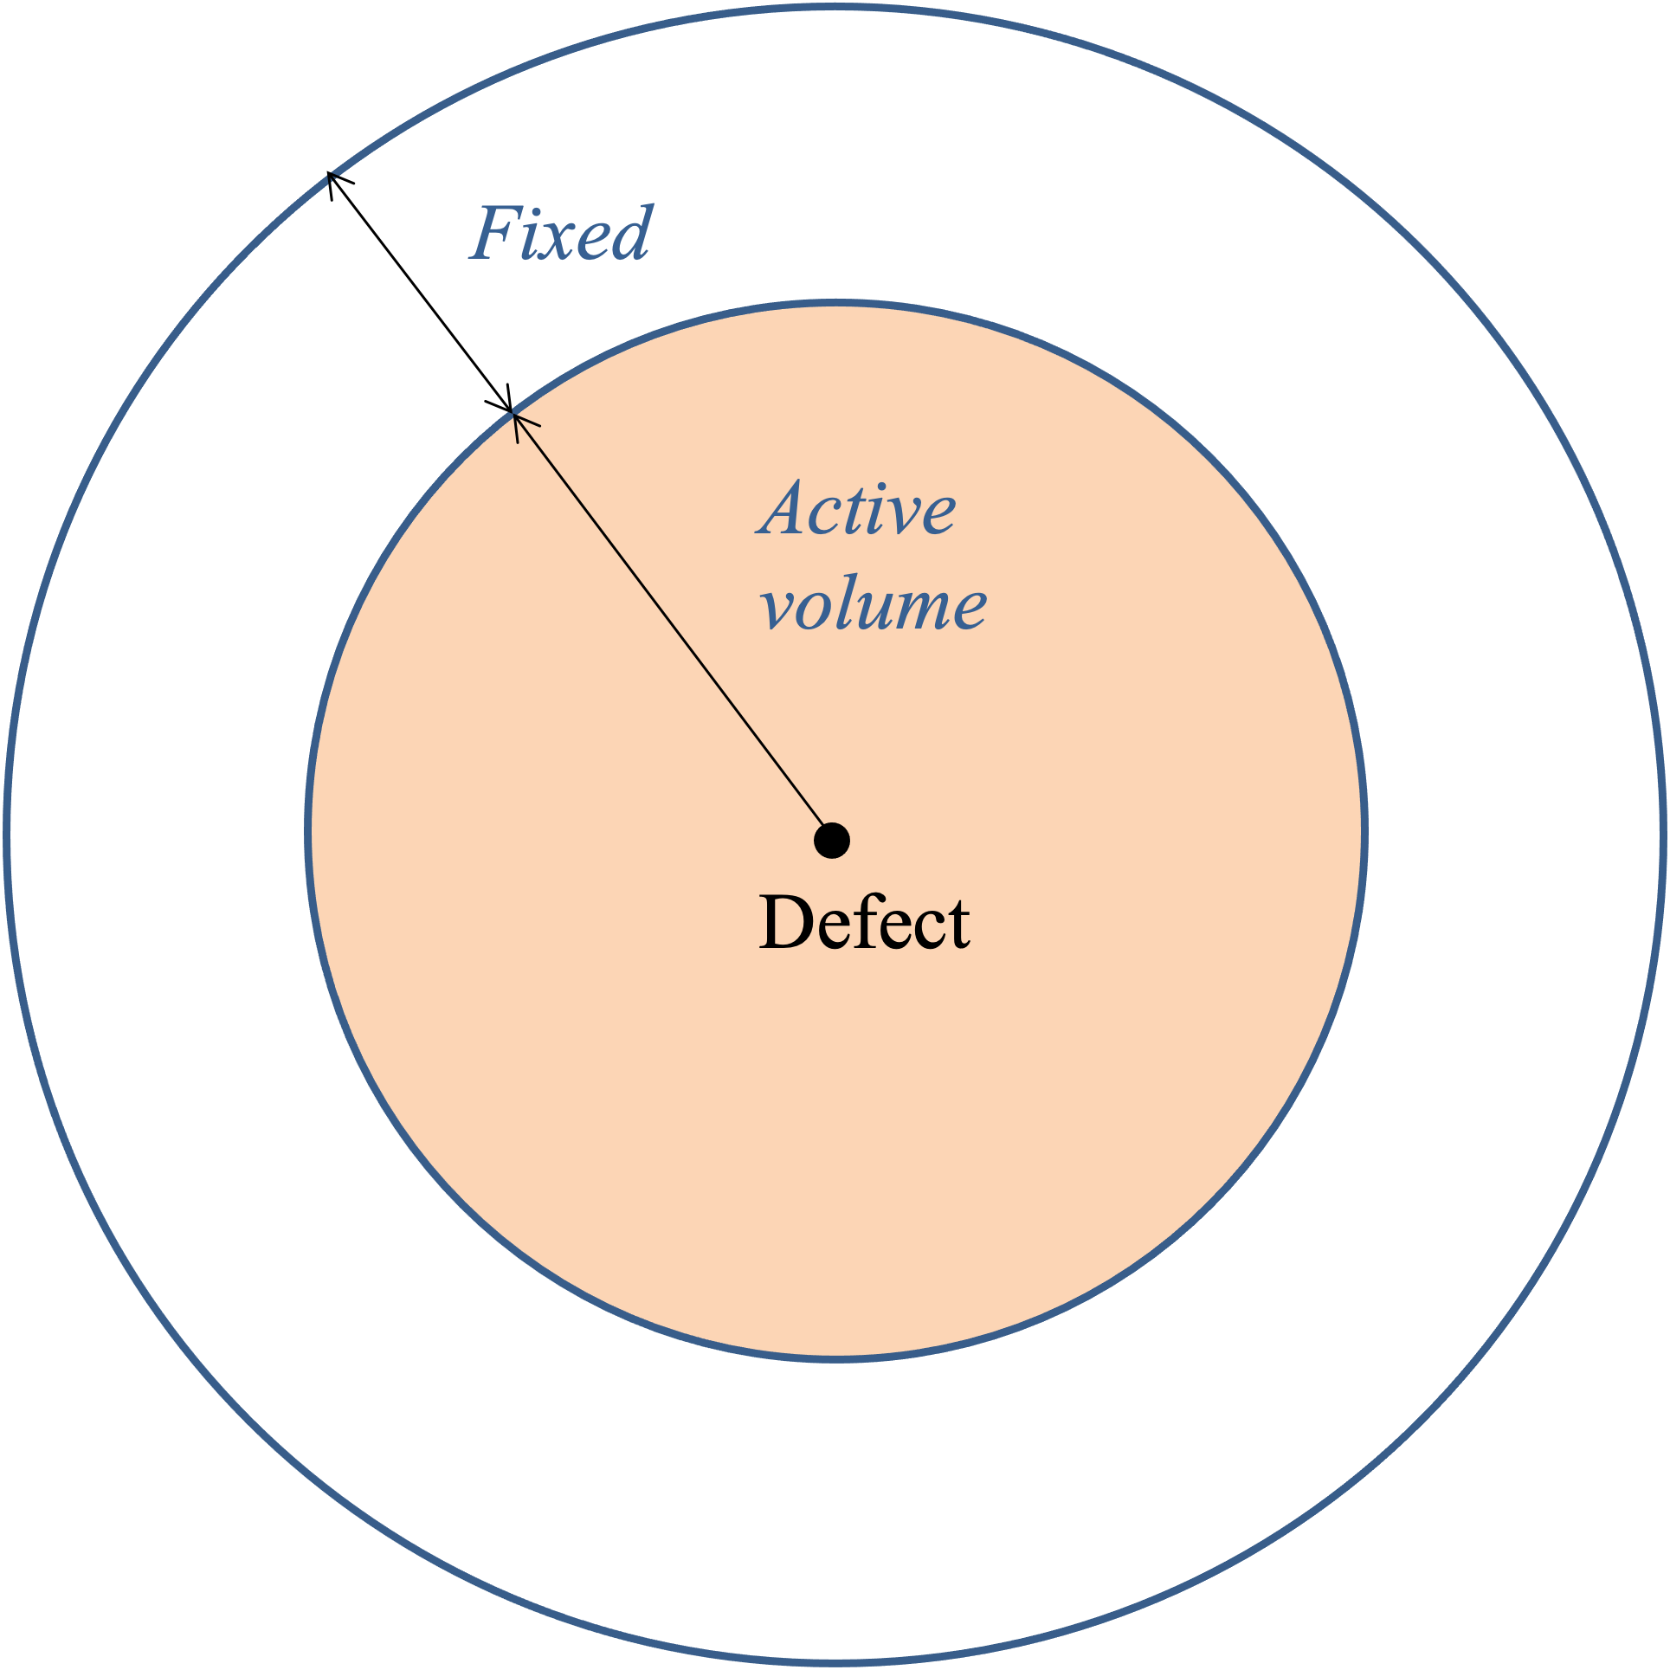
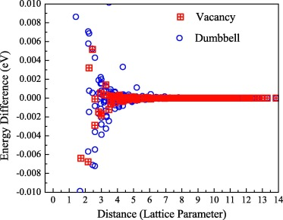
Active volume
Saddle points are often involved in localized region
Active volume (AV) is constructed according to presence of defects
Seakmc (self-evolving atomistic kinetic Monte Carlo)
H. Xu and et al, J. Phy.: Condensed Matter 24, (2012)
H. Xu and et al, Comput. Mat. Sci. 100, (2015)
Notes:
AV small enough to speed up sp
AV large enough that SP energy and positions are converged

Slide 6
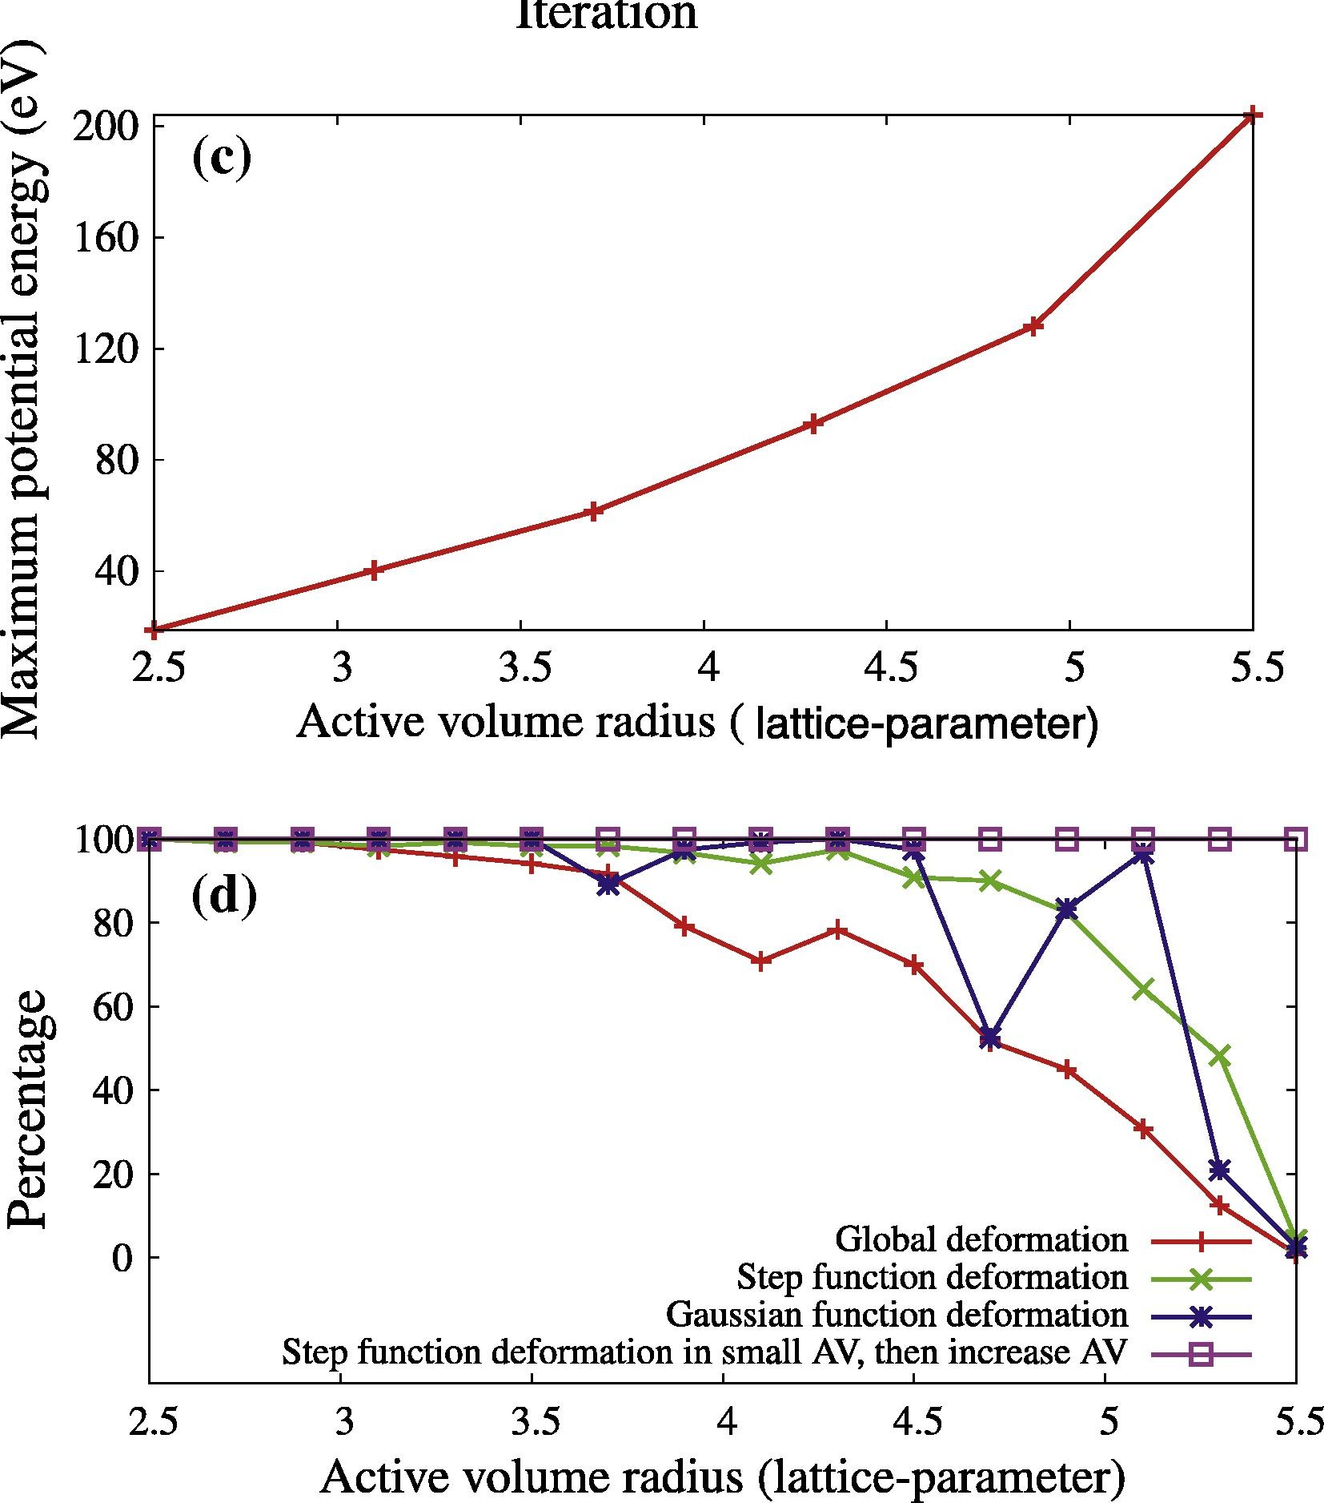
Existing challenges with saddle point search
vacancy
Max. potential energy increases with increasing size of AV
Probability of finding the saddle point decreases with increasing size of AV
vacancy
H. Xu and et al., Comput. Mat. Sci. 100, (2015)
Notes:
1) Max energy increases

Slide 7
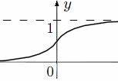
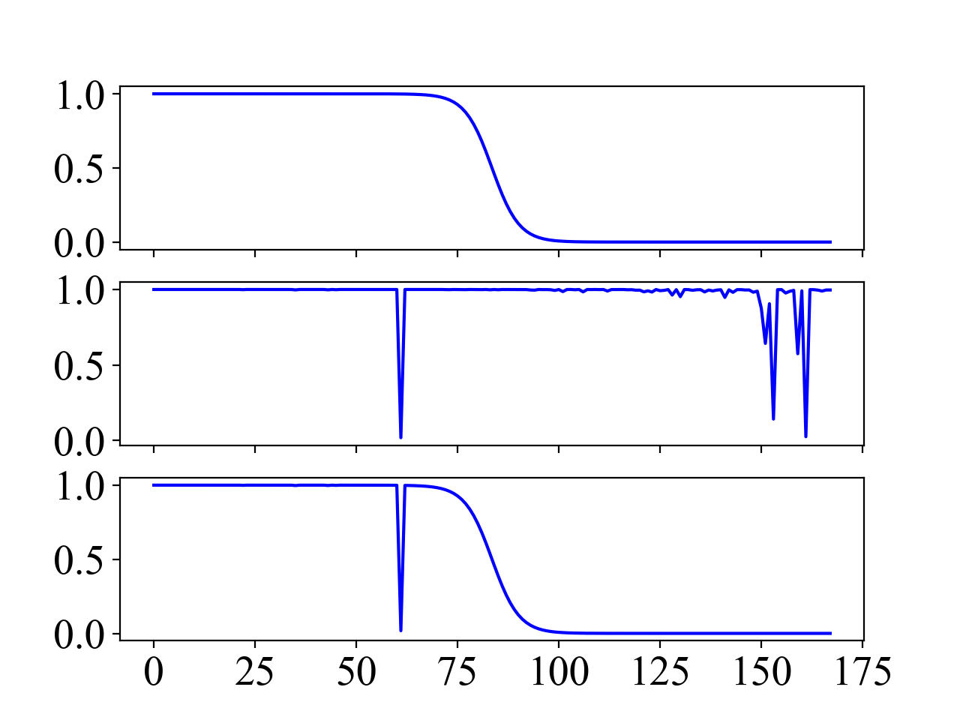
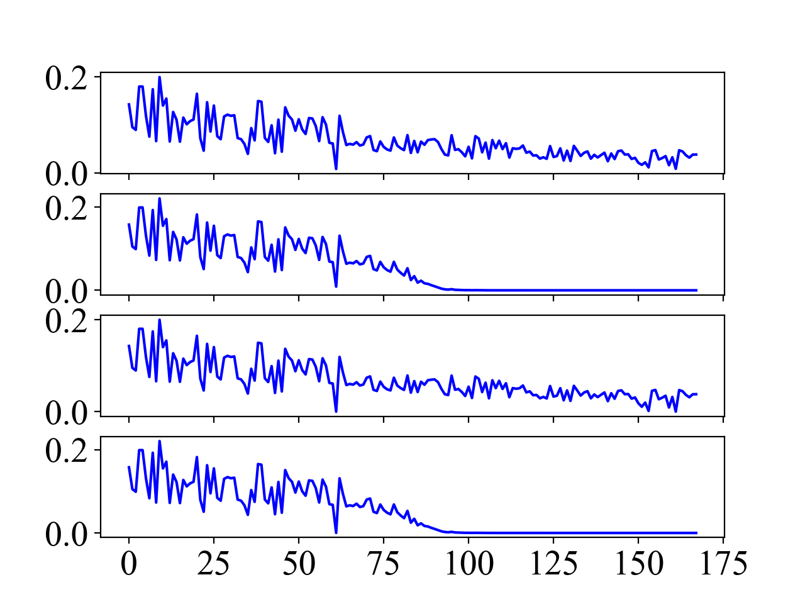
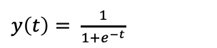
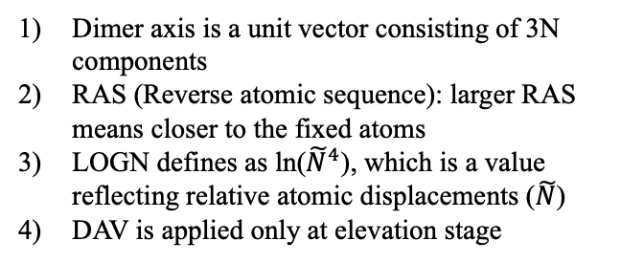
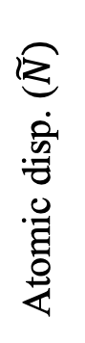
Dynamic active volume
DAV: Applying rescaling factors on dimer axis at elevation stage
T. Liang and H. Xu, Comput. Mat. Sci. 228, (2023)
Sigmoid rescaling
Dimer axis is a unit vector consisting of 3N components
RAS (Reverse atomic sequence): larger RAS means closer to the fixed atoms
LOGN defines as ln(${\tilde{N}}^{4}$), which is a value reflecting relative atomic displacements ($\tilde{N}$)
DAV is applied only at elevation stage
$y\left(t\right)= \frac{1}{1+e^{−t}}$
Deact.
Act.
t
Original
RAS
RAS
Rescaling factors
LOGN
Atomic disp. ($\tilde{N})$
LOGN
LOGN+RAS
LOGN+RAS
Atom sequence (168 atoms)
Atom sequence
Notes:
Not much details

Slide 8
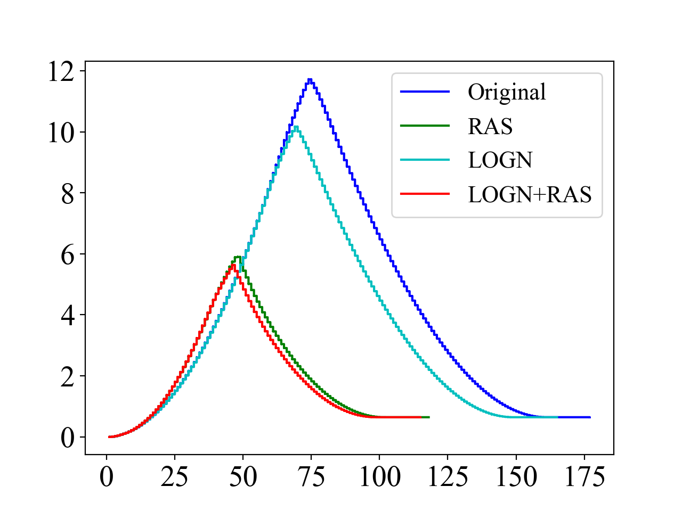
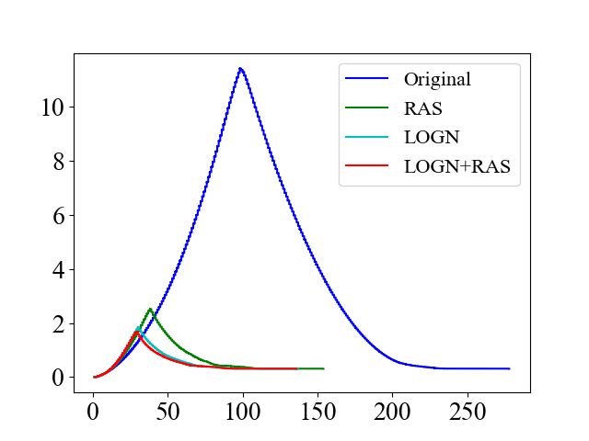
Benchmark with point defects
Fe-vacancy (168 atoms)
Fe-dumbbell (610 atoms)
Energy (eV)
Energy (eV)
Translation steps
Translation steps
8
Notes:
1) # of atoms in AV

Slide 9
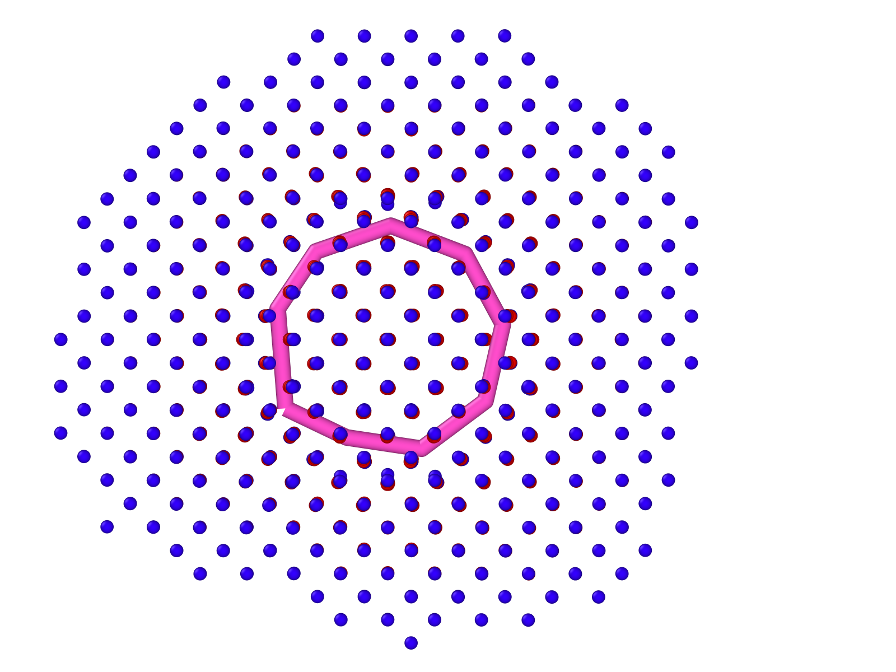

Fe – Self interstitial loop (SIL)
System/active volume configuration:
37-SIA cluster
[001]
∙
[010]
[100]
37 self interstitial atom (SIA) cluster
Active volume of Fe-SIL[100] (2006 atoms)
9
Notes:
An example of a complex defect, which requires a larger size of AV

Slide 10
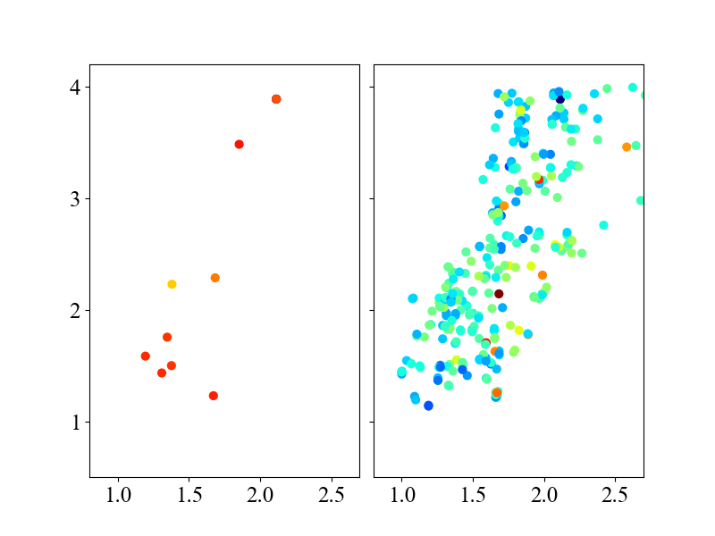
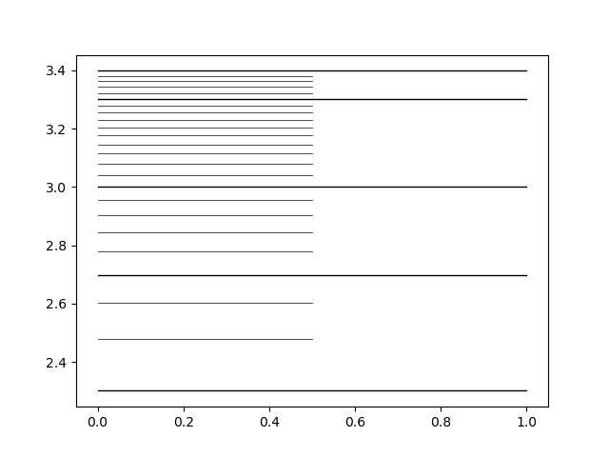
Fe – SILs with MCM2011 potential
Original
LOGN+RAS
# of steps
2500
2000
A 2006-atom AV
5000 attempts
2874 distinct saddle points for “Original” AV method, in which only 9 are connected
2408 distinct saddle points for DAV, in which 301 are connected
Barrier (eV)
1000
500
9 SPs w. 1658 steps
301 SPs w. 594 steps
200
Displacement (Å)
Displacement (Å)
L. Proville and et al, Nature Materials 11, (2012)
10

Slide 11
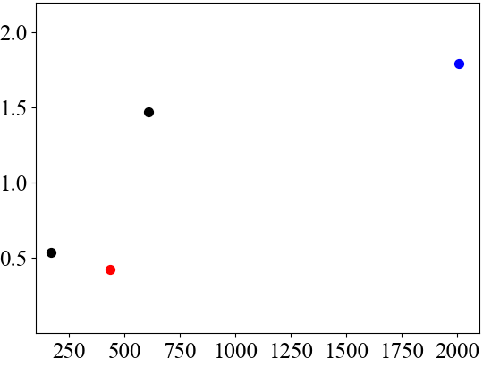
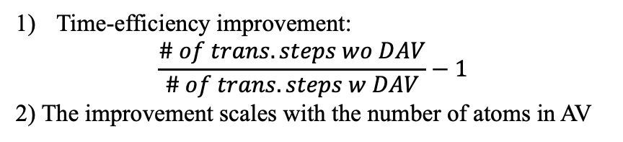
Summary
Time-efficiency improvement
Fe-SIL
Summaries:
Fe-dumbbell
Ratio of steps -1
Dynamic active volume can be applied if atomic displacements has a long-tail distribution
The time efficiency of a saddle point search with DAV can be significantly improved (42% to 179%)
The probability of finding the relevant saddle points using DAV has significantly increased
Fe-vacancy
Cu₅₆Zr₄₄ glass
Number of atoms
Time-efficiency improvement:
$$\frac{\# of trans. steps wo DAV}{\# of trans. steps w DAV}−1$$
2) The improvement scales with the number of atoms in AV
11

Slide 12
Flowchart of code implementation
Charactering AV
System inputs
Recycling
Finding PG
Barrier Recalibration
Loading DB
SNC
SP Search
KMC (LEB)
MD/Relax
AV relaxation
System relaxation
Finding Defects
Validating SPs
Post-processing SPs
To next KMC step, starting from Finding Defects
Save to DB

Slide 13
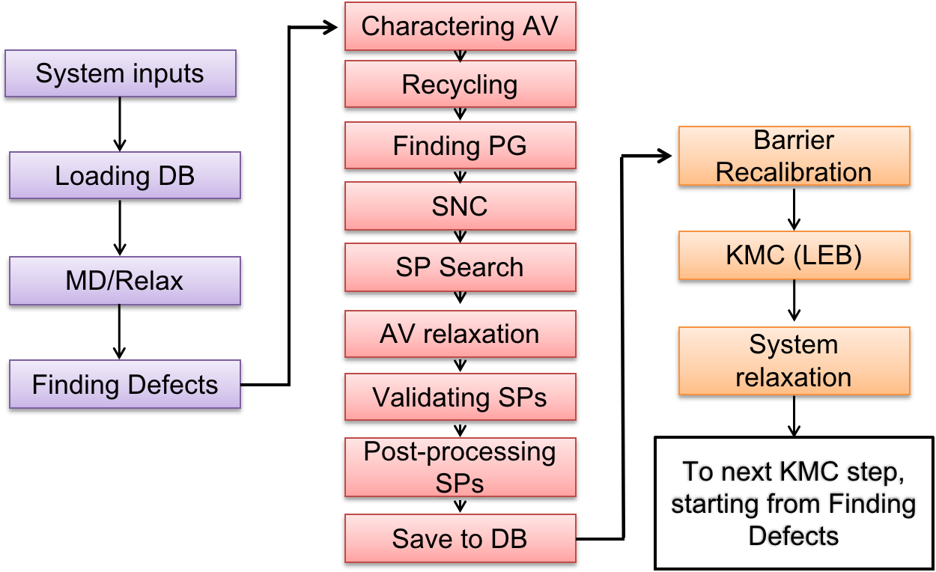
Parallization
Terminology:
ntask_tot: total number of tasks
nproc_task: number of processors per task
ntask_proc: number of tasks per processor
master_slave: master-slave work
ntask_tot: 1
nproc_task: max
no master-slave
ntask_tot: number of atoms
ntask_proc:
Evenly distributed
no master-slave
ntask_tot: number of AVs or SPs
nproc_task: large
master-slave
ntask_tot: number of SP searches
nproc_task: small
master-slave
13

Slide 14
Communicator Split
Example with master-slave:
size_world: 12
nproc_task: 3
Four Tags:
READY, START, DONE, EXIT
Slaves
key or rank_split
0
1
2
0
Master
1
color
2
idle
3
while completed_tasks < ntask_tot:
while Tag == EXIT:
1) M received READY,
M send START/idtask or EXIT/None
2) M received Done, update completed_tasks, undo_jobs,
M send START/idtask or EXIT/None
3) M received EXIT, update completed_tasks
1) S send READY
2) if S received START/idtask, do work and send DONE/idtask
3) if S received EXIT, break and send EXIT
14

Slide 15
Finding defective atoms
Available methods: BL, CN, BLCN, WS and custom
1. Local CN of an atom
2. Estimate equilibrium BL
Energy per Bond (eV)
Bond Length (Å)
trimer
Find a group of defective atoms (CN, BL strain or both)
Point defect reduction
dimer
hex
sq
dia
tri
sc
bcc
fcc
CN
Equilibrium BL increases as CN increases
absolute number of EPB decreases as BL increases
15

Slide 16
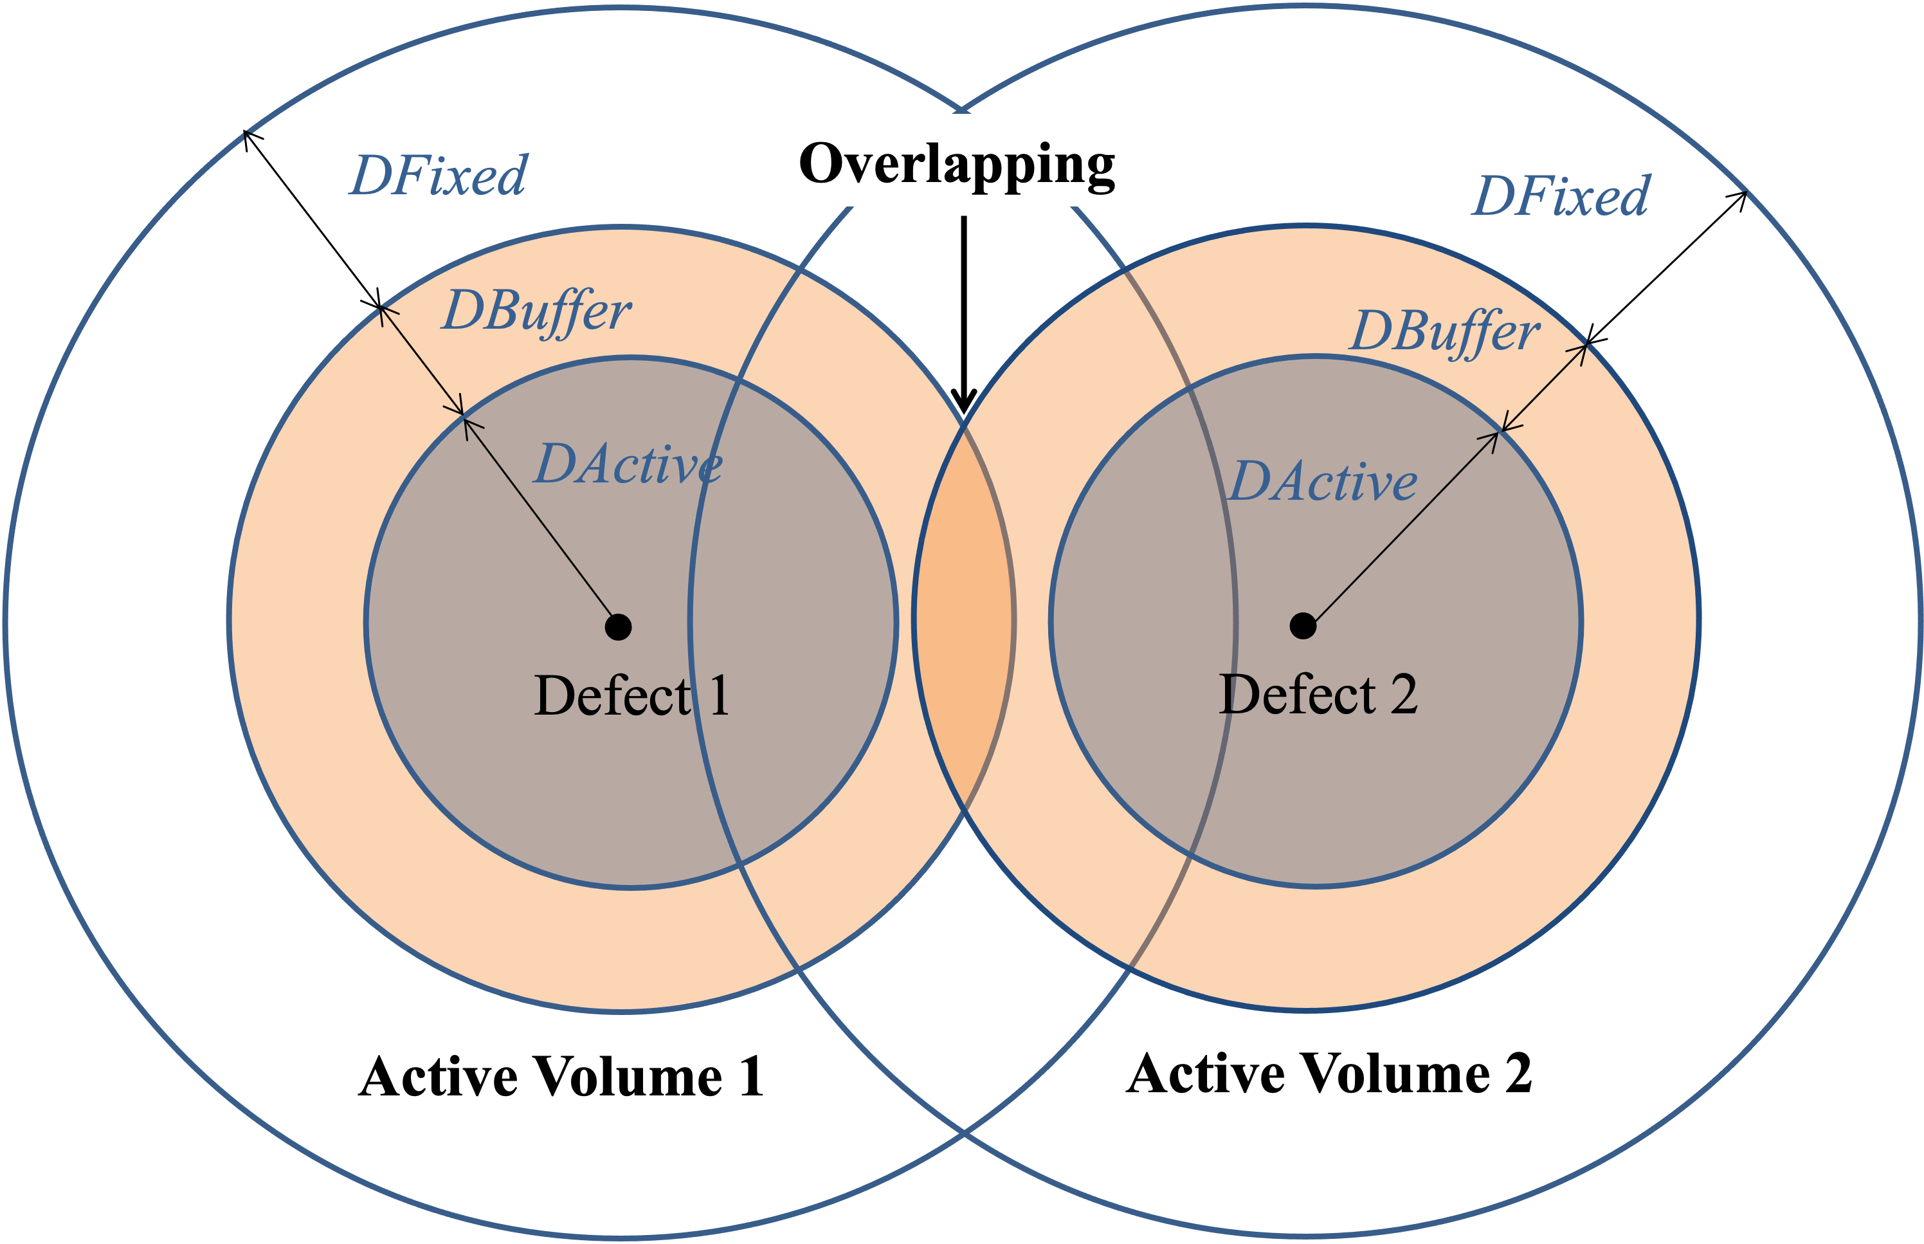
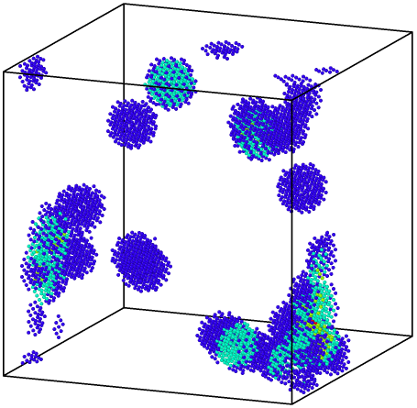
Building AV
Allow overlapping: AV is constructed on each defect
Not allow overlapping: AV is constructed as a union of AVs of a defect chain ( a super defect)
colored by degree of overlapping
16

Slide 17
Input.yaml in flowchart
active_volume
“input.yaml”
potential
saddle_point
force_evaluator
data
Kinetic_MC
active_volume
Dynamic_matrix
SNC
saddle_point
Validating SPs
Recycling
Post-processing SPs
defect_bank
Post-processing SPs

Slide 18
Parameters in active_volume
Automatically add “molecular-id” entry
potential:
Point defect reduction
bondlengths: the equilibrium bond length of each bond type
coordnums: the coordination number of each species
DCut4PDR
active_volume:
Active volume characteration
Style: style of finding defects
NPredef: number of pre-determined defects
FindDefects: a set of parameters to identify point defects
PDReduction: point defect reduction
DCut4PDR:
RecursiveRed:
DActive: radius of active volume
Overlapping:
RT_SetMolID, R4RT_SetMolID, FCT4RT_SetMolID: a set of parameters to define the region for characterizing AV
If an atom’s molecular-id < -NPredef, this atom will be considered a defect and won’t characterize the AV.
If an atom’s –Npredef <= molecular-id < 0, this atom will be considered a defect and won’t characterize the AV.

Slide 19
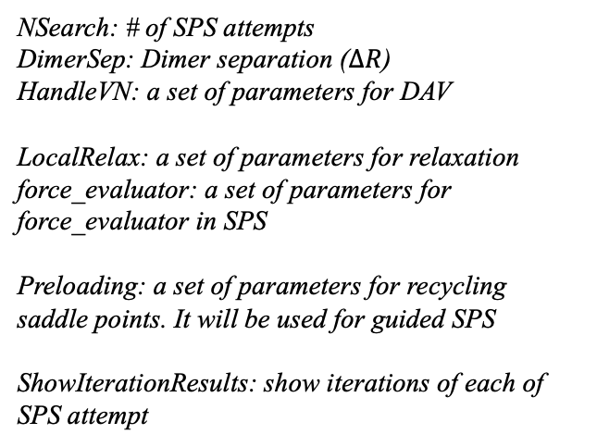
Parameters in Dimer method
spsearch:
max
NSearch: # of SPS attempts
DimerSep: Dimer separation ($∆R$)
HandleVN: a set of parameters for DAV
LocalRelax: a set of parameters for relaxation
force_evaluator: a set of parameters for force_evaluator in SPS
Preloading: a set of parameters for recycling saddle points. It will be used for guided SPS
ShowIterationResults: show iterations of each of SPS attempt
A2
A1
A4
A3
Dimer axis (N): a unit vector of R₁ – R₂
Notes:
No detail on dimer method
Highlight elevation / converging stages
A SP that is immediately connecting between initial and final states are a connected sp

Slide 20
Visual and output
Write_Data_SPs:
Sel_iSPs: all
DataOut directory:
KMC_istep.dat
KMC_istep_data_AVs.dat
KMC_istep_Data_SP_isp.dat
KMC_istep_Data_FI_isp.dat
Write_AV_SPs:
Write_Data_AV_SPs: True
Temporary folders:
AVOut directory:
KMC_istep.dat
KMC_istep_data_AVs.dat
KMC_istep_Data_SP_isp.dat
KMC_istep_Data_FI_isp.dat
Runner_i: a set of folders for i^{th} job. The maximum number is the maximum jobs can be run simultaneously
Root directory:
Seakmc.log
Seakmc_summary.csv
SPOut directory:
KMC_istep_Deleted.csv
KMC_istep_SPs.csv
KMC_istep_Prob.csv
KMC_istep_DetailSPs.csv

Slide 21
Interfaces with energy and force evaluators:
Code is coupled with Python LAMMPS
Code also has interfaces to VASP and LAMMPS binaries
Code download:
https://github.com/TaoLiang120/SEAKMC2_py_parallel
My email: tliang7@utk.edu
21

